Slide 1
Project Workflow

Slide 2
Project Workflow
How do you do it?
-Discussion-

Slide 3
Project Workflow
If you are anything like every programmer
Think about the project for a bit
Start writing code
Adjust as needed

Slide 4
Is there a better way?

Slide 5
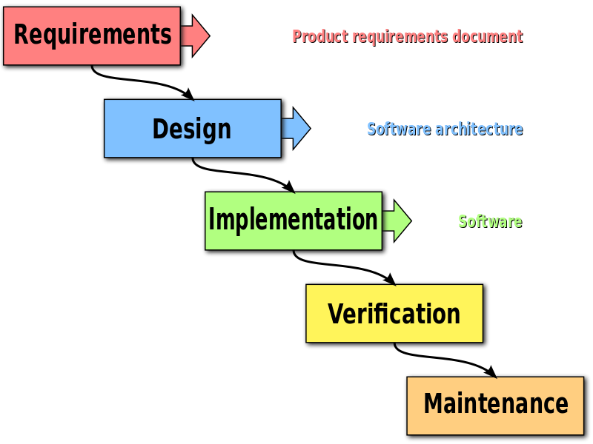
Waterfall Method

Slide 6

Waterfall Method
Has been used for years
Methodology works well in engineering

Slide 7
Waterfall for Software
Gather requirements
customer: “This is what we want”
dev team: “Got it. See you in a year!”
Requirements documents
Design software architecture
Design documents
Write tasks
Generate timelines
Set deadlines

Slide 8
Waterfall for Software
Write code
Implement the functionality set forth in the design documents
Test code
Proceed when all features from design document are working properly
Deliver final product
Maintain Software

Slide 9
Waterfall for Software - A Scenario
Deliver final product:
customer: “This isn’t what we wanted”
Dev team: “This is exactly what you asked for!”
customer: “This isn’t what we wanted!”

Slide 10
Now what?

Slide 11
Waterfall for Software
And what about all the documents and architecture?
Waterfall can work well when the customer very clearly communicates their needs
Specs might be captured in a small number of short meetings
Customers are busy too
What if the dev team isn’t part of these meetings?

Slide 12
Is there a better way?

Slide 13
agile
Aligned with how we actually make software
Think about the project for a bit
Write code
Adjust as needed

Slide 14
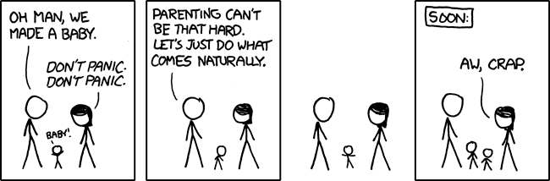
agile – “doing what come naturally”
Not always the best idea, but let’s give it a try

Slide 15
Manifesto for Agile Software Development
We are uncovering better ways of developing software by doing it and helping others do it. Through this work we have come to value:
Individuals and interactions over processes and tools Working software over comprehensive documentation Customer collaboration over contract negotiation Responding to change over following a plan
That is, while there is value in the items on the right, we value the items on the left more.

Slide 16
Principles behind the Agile Manifesto
We follow these principles:
Deliver valuable software early and often
Welcome changing requirements
Even late in the development process
Business people and developers must work together daily throughout the project.

Slide 17
Principles behind the Agile Manifesto
We follow these principles:
Build projects around motivated individuals
Give them the environment and support they need
Trust them to get the job done.
Communicate face-to-face

Slide 18
Principles behind the Agile Manifesto
We follow these principles:
Working software is the primary measure of progress.
Agile processes promote sustainable development.
The sponsors, developers, and users should be able to maintain a constant pace indefinitely.
No overtime at crunch time
Continuous attention to technical excellence and good design enhances agility.

Slide 19
Principles behind the Agile Manifesto
We follow these principles:
Simplicity--the art of maximizing the amount of work not done--is essential.
The best architectures, requirements, and designs emerge from self-organizing teams.
At regular intervals, the team reflects on how to become more effective, then tunes and adjusts its behavior accordingly.

Slide 20
CSE442
It should be clear that this course was designed with agile in mind
Or did I just do what came naturally?

Slide 21
agile and scrum
agile
Abstract
scrum
Concrete implementation of agile

Slide 22
Scrum - Gathering requirements
Stories
Customer “tells a story”
Non-technical
ex: “When I check a piece of equipment, I want to know all the information about it.”
Tasks
Technical requirements needed for stories
ex:
host a database of equipment information
track equipment with barcodes
convert scanned codes into SQL queries
display query results to the user

Slide 23
Scrum - Sprints
Deliver working code at fixed intervals
Sets a pace for the project
Typically 1-4 weeks/sprint
After each sprint
Demo the software to the customer
Discuss the direction of the project
Adjust as needed

Slide 24
Scenario Revisited
Gather requirements
customer: “This is what we want”
Dev team: “Got it. See you in a week!”
write code
deliver code
customer: “This isn’t what we wanted”
dev team: “Show us what you want”
Revise requirements
write code
deliver code
customer: “This is a little better”
dev team: “Tell us more”
Revise requirements
Repeat

Slide 25
Scrum: Co-located teams
All team member meet face-to-face often
Communication
Communication
Communication
At what cost?
Some companies will not hire remote employees
Google included

Slide 26
Scrum board
Visualization of the state of the project
Column for the state of each task
backlog/blocked
in progress
testing
complete
Move tasks across the board as they progress
Column names vary by team
Ideally is displayed physically

Slide 27
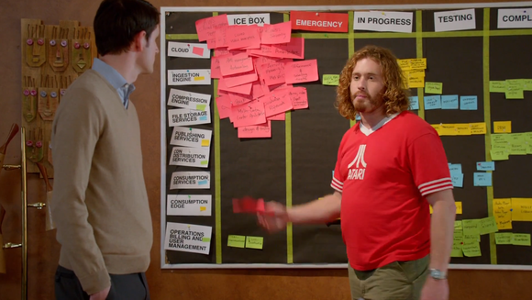
Scrum board

Slide 28
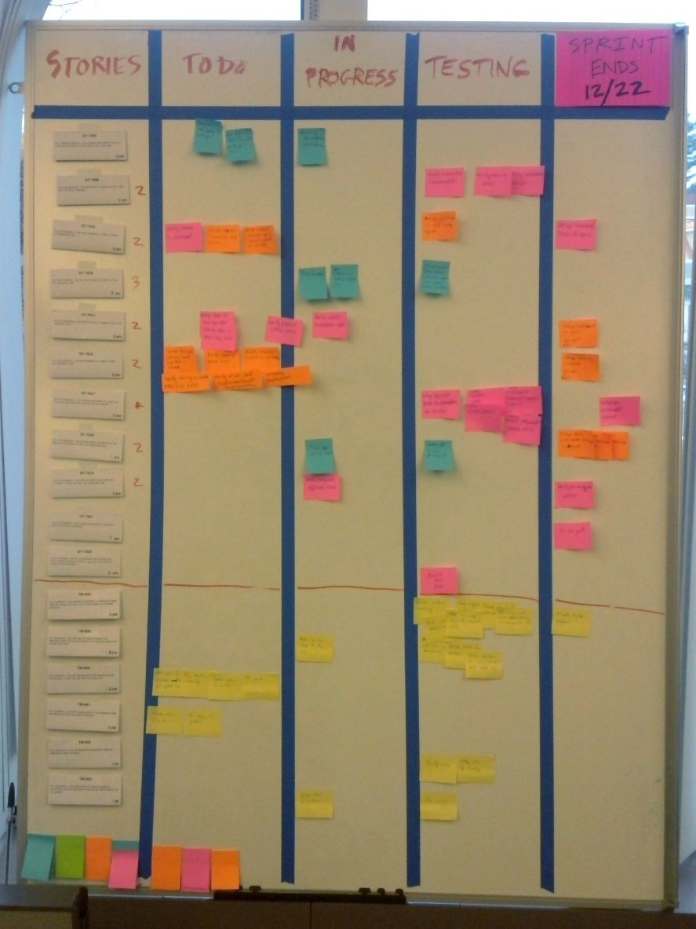
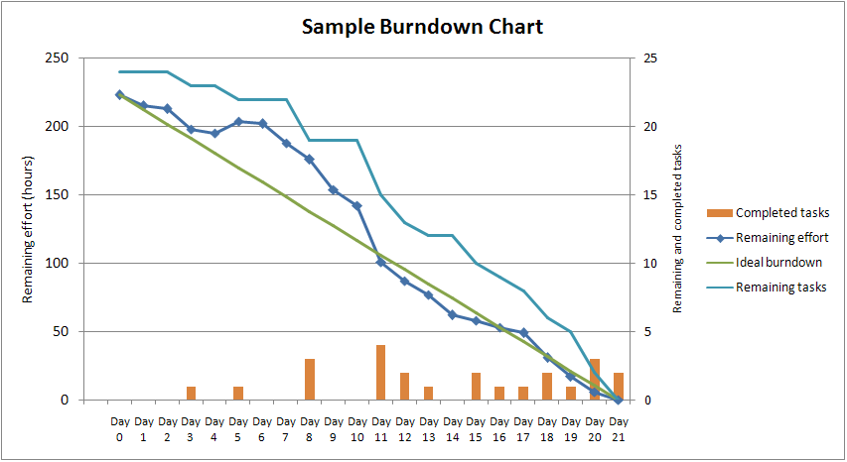
Visualizations!

Slide 29
Scrum in practice
Do what works for you
Modify scrum for fit your needs

Slide 30
Scrum this semester
3 sprints/submissions
Minimal documentation
Maximum interaction between team members
Piazza groups
GitHub
Meetings
email?

Slide 31
Scrum this semester
*Recommended*
not required
Generate stories
Divide stories into tasks
Give each task a time estimate
Assign each task a group member(s)
Track tasks in GitHub or productivity software
Scrum board

Slide 32
This slide intentionally left blank

